Slide 1
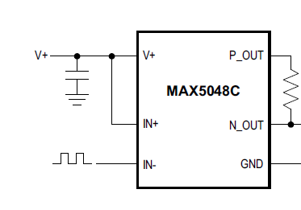
Fast Pulse Option From MAXIM
5 V
5 V
To TR switch control
10
0 V / 3.3 V from FPGA
That 10 Ohm might be able to be replaced
with a short, TBD

